Slide 1

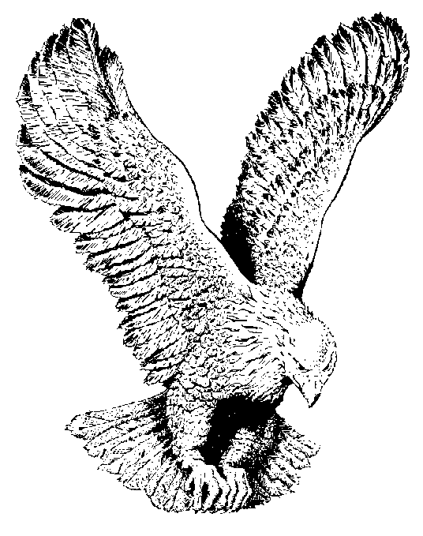
MY LORD KNOWS THE WAY
My Lord knows the way
Through the wilderness;
All I have to do is follow.
My Lord knows the way
Through the wilderness;
All I have to do is follow.
Strength for today is mine always,
And all that I need for tomorrow;
My Lord knows the way
Through the wilderness;
All I have to do is follow.

